Slide 1
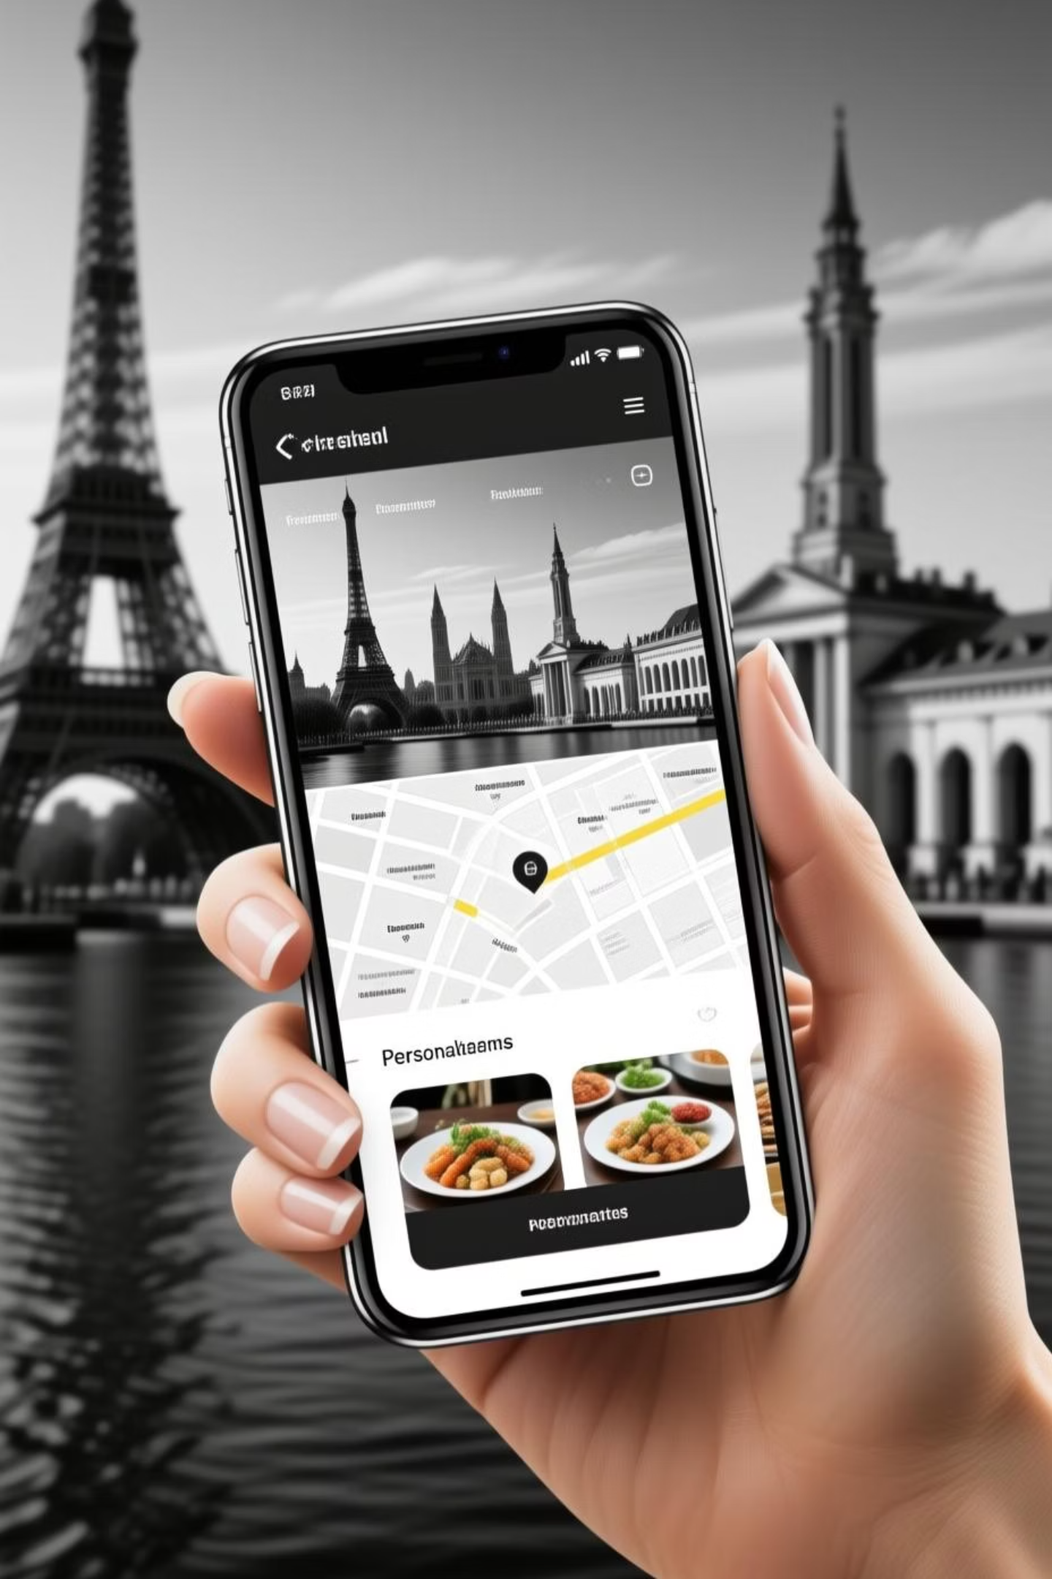
Travel Itinerary Planner with AI: Your Personal Trip Designer
Welcome to a new era of travel planning. Discover how our AI-powered solution transforms the complex process of organizing trips into a seamless, enjoyable experience.

Slide 2
The Challenges of Trip Planning
Overwhelming Information
Time-Consuming Research
Travelers face a deluge of websites, blogs, and reviews, making it hard to find reliable and relevant information for their specific needs.
Crafting a detailed itinerary, from flights and accommodation to daily activities and dining, often takes hours, even days, of dedicated research.
Lack of Personalization
Coordination Complexity
Generic itineraries rarely match individual preferences, budget constraints, or travel styles, leading to less fulfilling trips.
Planning for groups or navigating multi-city trips adds layers of complexity, making coordination a significant headache.

Slide 3

Solution Overview: How Our AI Travel Planner Works
Our AI-powered travel planner simplifies trip organization by taking your inputs—city, budget, and number of days—and instantly generating a comprehensive, day-by-day itinerary.
Summaries for each day's activities
Integrated maps for easy navigation
Curated dining recommendations
Seamless adjustments based on preferences
It's like having a personal travel agent, available 24/7, tailored precisely to your journey.

Slide 4
Core Feature: Personalized Itineraries Based on User Inputs
City Selection
Budget Range
Users input their desired destination, from bustling metropolises to serene coastal towns.
Users define their spending comfort, from luxury travel to budget-friendly adventures, ensuring recommendations align with financial plans.
Number of Days
Personal Preferences
The itinerary dynamically adjusts its depth and scope based on the duration of the trip, ensuring a balanced schedule.
Optional fields allow users to specify interests (e.g., history, food, adventure) for hyper-personalized suggestions.

Slide 5
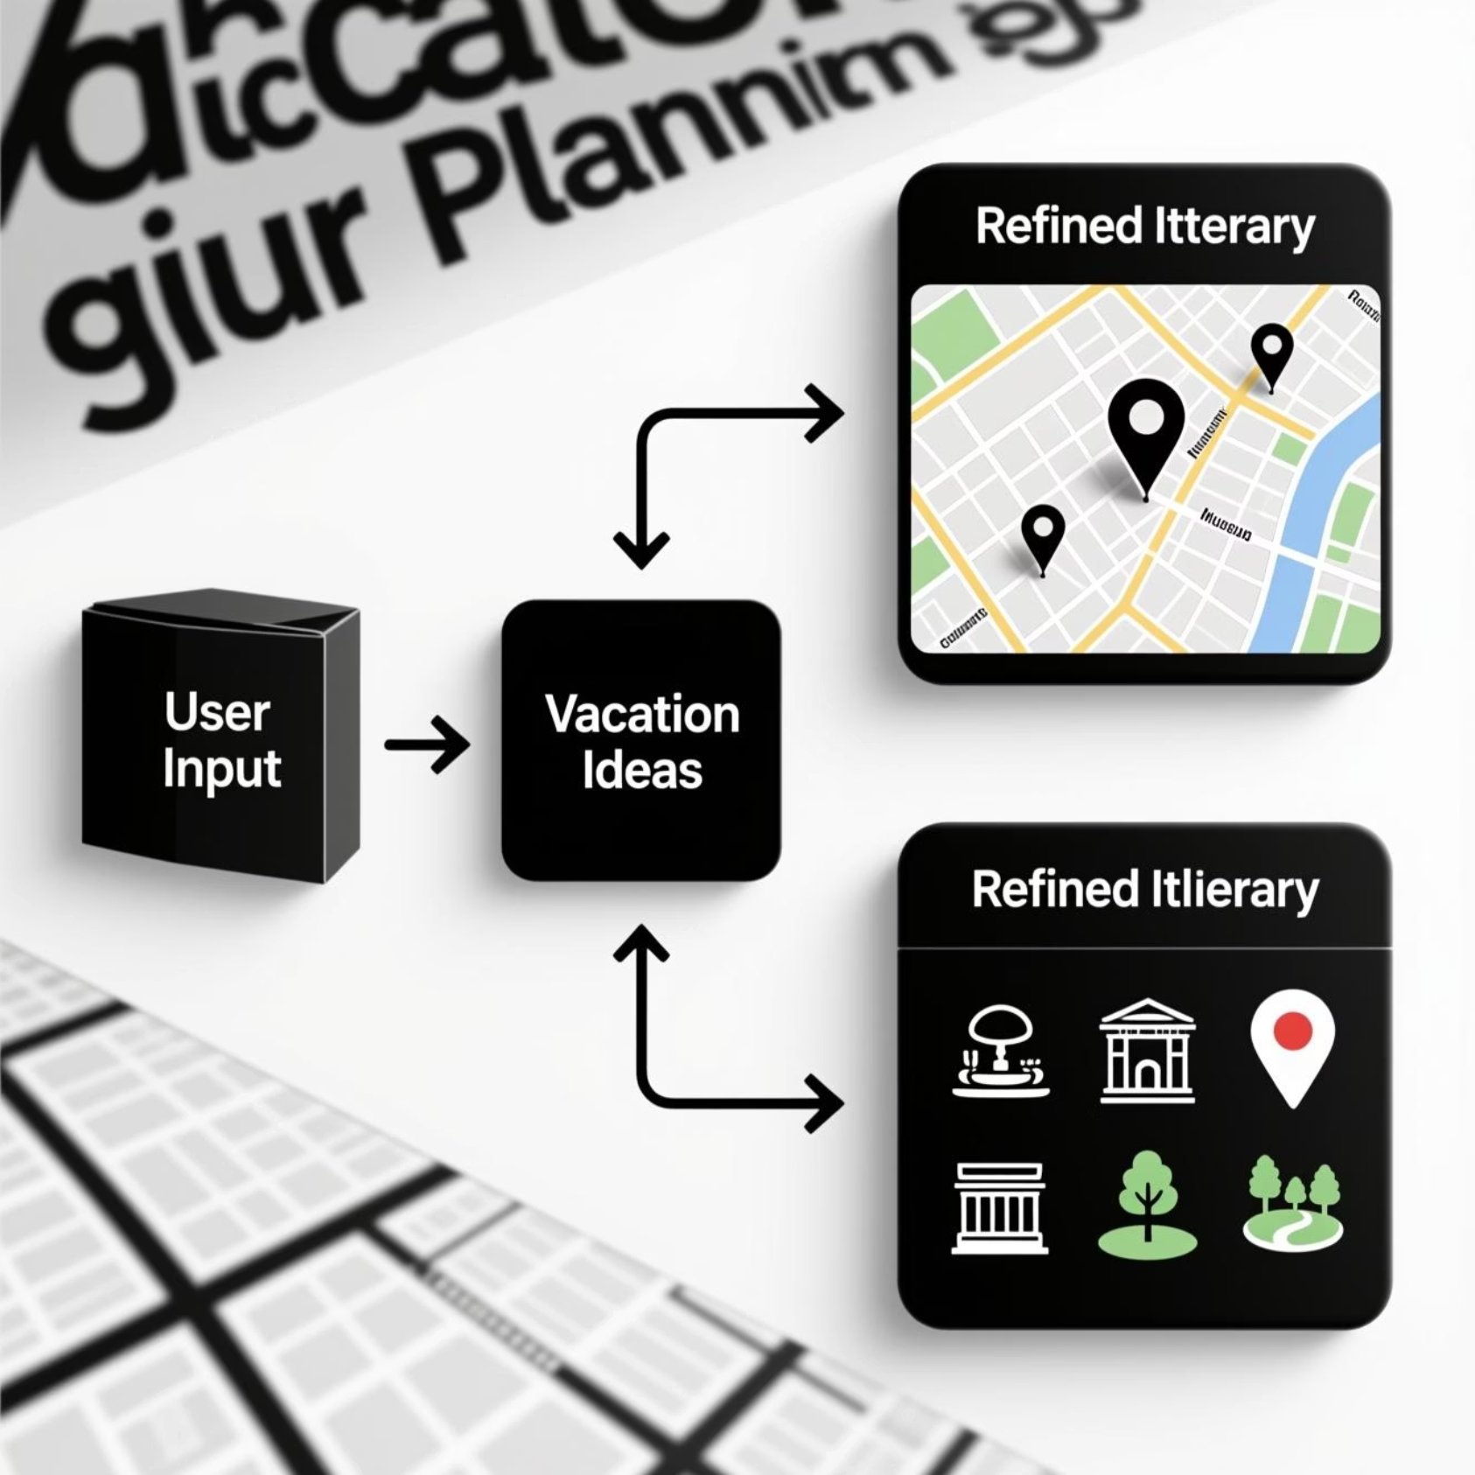
Implementation Details: Prompt Chaining and Multi-Step LLM Calls
Our AI leverages sophisticated prompt chaining to break down complex itinerary generation into manageable steps.
Initial Query: User inputs form the first prompt.
Contextualization: LLM identifies key themes (e.g., "romantic Paris," "budget Tokyo").
Day-by-Day Breakdown: Subsequent prompts generate daily plans, activities, and routes.
Refinement Loops: Iterative calls to refine suggestions, ensuring coherence and quality.
Integration: Final output combines LLM insights with Google Maps data.

Slide 6




UI/UX Design: Creating an Intuitive User Experience
Our design philosophy centers on simplicity and clarity, ensuring travelers can easily navigate and customize their itineraries.
Intuitive Navigation
Customization Options
Clean layouts and logical flow allow users to quickly input details and access their generated itineraries.
Easy-to-use controls for adjusting activities, dining, and timelines within the generated plan.
Visual Itineraries
Responsive Design
Integrated maps and image suggestions provide a clear visual overview of each day's plan.
Optimized for seamless use on desktop, tablet, and mobile devices, making planning accessible anywhere.

Slide 7

Case Study: Sample Trip Planning from Start to Finish
User Input:
Generated Itinerary (Excerpt):
City: Rome
Day 1: Ancient Wonders
Budget: Mid-range
Morning: Colosseum & Roman Forum (guided tour)
Days: 4
Lunch: Trattoria near Pantheon (authentic Roman)
Afternoon: Pantheon & Piazza Navona
Preferences: History, Food, Art
Evening: Dinner in Trastevere, explore charming alleys
Day 2: Vatican & Baroque Art
Morning: Vatican Museums & St. Peter's Basilica
Lunch: Pizza al taglio near Vatican
Afternoon: Castel Sant'Angelo & Ponte Sant'Angelo
Evening: Trevi Fountain & Spanish Steps, gelato break

Slide 8



Challenges and Solutions: Overcoming Technical Hurdles
Data Accuracy
Response Time
Nuance & Ambiguity
Ensuring LLM outputs are factually correct and current for locations and recommendations.
Minimizing latency for complex multi-step LLM calls to provide a smooth user experience.
Handling subjective user preferences and ambiguous inputs effectively.
Solution: Implement robust validation against Google Maps and reputable travel databases.
Solution: Optimize API calls, leverage caching, and explore parallel processing for prompts.
Solution: Implement user feedback loops and fine-tune LLM models with diverse travel scenarios.

Slide 9

Next Steps and Future Enhancements
User Accounts & Saving: Allow users to save, edit, and share itineraries.
Real-time Updates: Integrate live data for events, weather, and transport delays.
Booking Integrations: Partner with flight, hotel, and activity booking platforms.
Multi-Modal Planning: Support planning for car rentals, train journeys, and more.
Voice Interface: Enable hands-free itinerary generation and modification.

